Slide 1
VITAL: Visual tracking via adversarial learning
Yibing song, Chao Ma, xiaohe wu, Lijun Gong, linchao bao, wangmeng zuo, chunhua shen, rynson Lau, and Ming-hsuan Yang

Slide 2
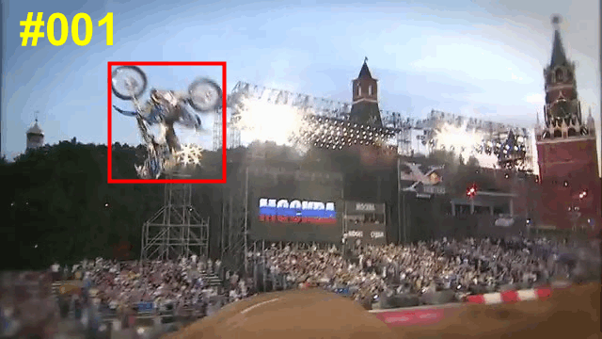
Notes:
In visual tracking, we aim to locate single target object in the videos. Given one ground truth object annotation in the first frame, we develop algorithms to track the target object in the remaining frames. As there is no prior knowledge of the target object expect for the first frame annotation, it is quite challenging to accurately track the object, especially when it contains significant appearance variations. Examples include in-plane and out-of-plane rotation, illumination variance, occlusion and deformation.

Slide 3
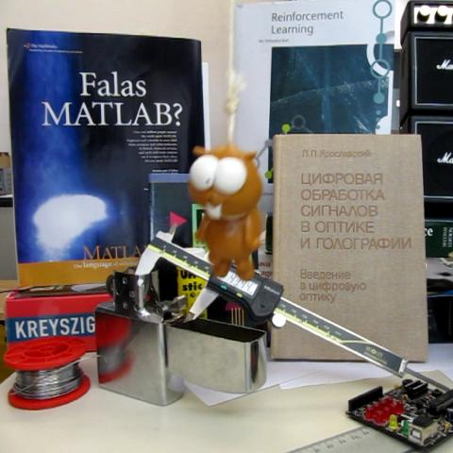
Two-stage tracking-by-detection framework
Negative
Positive
Negative
Negative
Testing
Notes:
The state-of-the-art tracking-by-detection framework typically consists of two steps to localize target object. In the first step, they draw multiple samples near the target region of the previous frame and then classify each sample as either the target or the background.

Slide 4
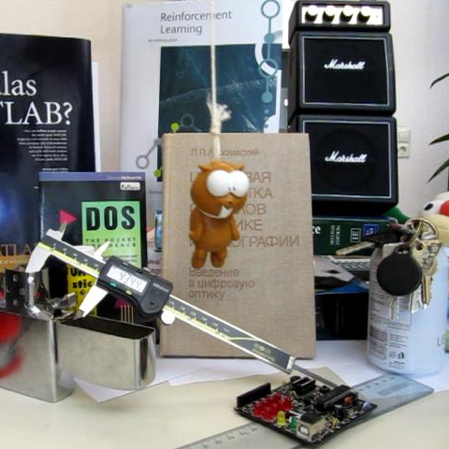
Two-stage tracking-by-detection framework
Binary classifier
Positive sample
Negative sample
Training
Notes:
The online training process of the classifier is based on each input sequence. In the initial frame, multiple samples are collected and labeled based on their overlapping extent with the ground truth annotation. They use these samples to train a binary classifier which differentiates the target and background in the next few frames.

Slide 5
Our observations:
The positive samples are highly
spatially overlapped.
Class imbalance between positive
and negative samples.
Notes:
In practice, we find that the positive samples are all around the target object, which are highly overlapped. These samples are not able to capture rich appearance variations over time. Meanwhile, the extreme foreground-background class imbalance negatively affects training the classifiers.

Slide 6
Our intuitions:
Diversifying positive samples through adaptive dropout.
Cost sensitive loss for alleviating class imbalance.
Notes:
In this work, we take advantage of the recent progress in adversarial learning to augment positive samples to facilitate classifier training. Meanwhile, we propose a high-order cost sensitive loss to decrease the effect of easy negative samples.

Slide 7




Review of GAN:
$$ℒ=\min_{G}{\max_{D}{𝔼_{x\sim P_{data}(x)}}}\left[\log{D\left(x\right)}\right]$$
$$+𝔼_{z\sim P_{noise}(z)}[log⁡(1−D(G(z)))]$$
$G$ takes a noise vector $z$.
$D$ differenciates $G(z)$ and a real image $x$.
$G$ is learned to maximize the probability of $D$ making a mistake.
$G$ and $D$ are trained in every iteration.
Notes:
Here we review the generative adversarial network. It consists of a generator G and a discriminator D. We show the objective function during the training step. The generator takes a noisy vector as input and outputs one image. The discriminator differentiates this image and a real image. The classification loss is back propagated to update G. In every training iteration, G and D are trained jointly.

Slide 8
Our observations:
A direct applying of GAN into the tracking-by-detection framework is not feasible.
The input data are usually candidate object proposals rather than random noise.
The classifier training process is supervised instead of unsupervised learning.
We expect to use the classifier (i.e., D) for inference rather than the generator G.
Notes:
Read the captions should be fine.

Slide 9



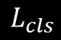
Proposed Framework:
Feature Extractor
Adversarial Feature Generator
Binary Discriminator
Weight
Mask
Fully
Connected
Layers
Mask generation
from loss
Feature
Maps
Fully
Connected
Layers
Training:
Classification loss
$$L_{cls}$$
Conv
Layers
$$×$$
Adaptive
Dropout
Prediction:
Binary classification
Notes:
We present our framework here. It consists of a feature extractor, adversarial feature generator, and a binary discriminator. The generative network augments positive samples by generating weight masks randomly applied to the features, where each mask represents a specific type of appearance variation. Through adversarial learning, our network can identify the mask that maintains the most robust features of target appearance in the temporal domain. The learned mask is able to decrease the weights of discriminative features, which tends to overfit the classifier in a single frame. In other words, adversarial learning helps our tracker exploit the most robust features over a long temporal span during training, rather than overfitting to discriminative features in a single frame.

Slide 10




Adversarial Learning:
$$ℒ_{VITAL}=\min_{G}{\max_{D}{𝔼_{\left(C,M\right)\sim P_{(C,M)}}[\log{D(M∙C)}] }}$$
$+𝔼_{C\sim P_{(C)}}\left[\log\left(1−D\left(G\left(C\right)∙C\right)\right)\right]$
$+λ𝔼_{\left(C,M\right)\sim P_{(C,M)}}{||G\left(C\right)−M||}^{2}$
$C$ is the input feature.
$G\left(C\right)$ is the generated mask.
$M$ is the actual mask identifying the discriminative features.
Dot is the dropout operation on the feature $C$.
Notes:
We show our objective function here. The generator predicts a mask and weigh the input features. The discriminator is learned based on these refined features. Meanwhile, we add a L2 norm to regularize the weighted mask.

Slide 11



Adversarial Learning:
In each training iteration
Training $D$:
Input feature refinement through mask filtering.
Labels unchanged for supervised learning.
Training $G$:
Random mask generation.
Select one mask which creates highest loss by passing the refined features into $D$.
Set this mask as $M$ for learning $G$.
Notes:
When performing adversarial learning in each iteration, we first train D and then G. We use G to predict mask according to every input feature. The mask is then combined with these features through pixel wise multiplication. Meanwhile, we remain the labels for supervised learning. When training G, we first prepare several random masks and select the one with the highest loss. Then we set this mask as M in the adversarial learning step.

Slide 12





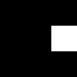



Visualization: mask preparation
We have prepared 9 random masks to capture the discriminative features.
Notes:
We prepare 9 random masks in advance. These masks are shown here. Each of these masks occlude part of the feature and they will cover all the features in total.

Slide 13
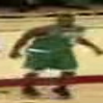
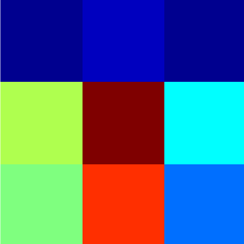

Visualization: mask prediction
(a) Input sample
(b) CNN feature
(c) Predicted mask
In the training step, our predicted mask is learned to reduce the effect
from discriminative CNN features.
Notes:
Here we show the visualization of the CNN feature and predicted mask. Given an input sample shown in (a), we obtain its CNN feature in (b) and the mask predicted by G in (c). The CNN features have indicated that part of the spatial regions of the features is discriminative to differentiate the target object. These regions are located in the mask and their effect on the classifier training will be reduced.

Slide 14

Visualization: how adversarial learning affects the classifier?
Entropy distribution of the binary classifier.
$$H=−(p∙\log{p}+(1−p)∙\log{(1−p)})$$
$p$ and $1−p$ are predicted class probability.
The higher the entropy, the more uncertain of the classifier.
Notes:
Besides mask visualization, we show how adversarial learning affects the classifier. The entropy is adopted to measure the prediction uncertainty of the classifier.

Slide 15
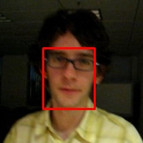
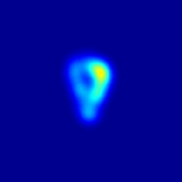
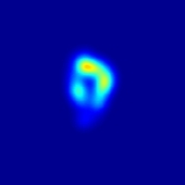
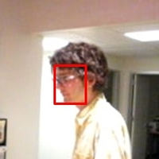
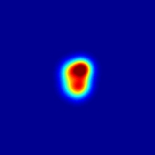
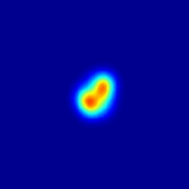
Visualization: how adversarial learning affects the classifier?
Highest
(a) Input
Frame #003
(b) Entropy map
Without GAN
(c) Entropy map
With GAN
Entropy intensity bar
Lowest
(d) Input
Frame #160
(e) Entropy map
Without GAN
(f) Entropy map
With GAN
Notes:
We compute the entropy map of the baseline tracking-by-detection framework with and without adversarial learning. At the beginning of one sequence, the entropy map of both of the two strategies are similar. However, when the target object undergoes appearance variations, the values on the entropy map become large on the baseline configuration. It indicates that the classifier trained without adversarial learning is uncertain on the current prediction. In comparison, the classifier trained using adversarial learning is more certain on differentiating the target and the background.

Slide 16


Cost sensitive loss:
Review of cross entropy loss
$$ℒ_{CE}=−(y∙\log{p}+(1−y)∙\log{(1−p)})$$
$y∈\{0, 1\}$ is class label.
$p∈[0, 1]$ is estimated class probability.
Notes:
To alleviate the class imbalance effect, we propose a cost sensitive loss during training. It extends the cross entropy loss, which is reviewed here. We take the binary form of the cross entropy loss for illustration. The objective function is shown here where y is the class label and p is the predicted probability.

Slide 17
Cost sensitive loss:
Easy negatives ($p≪0.5$and $y=0$) produce the loss with non-trivial magnitude.
A summation of these loss will overwhelm the valuable rare positive samples.
$$ℒ(p,y)=−(y∙(1−p)∙\log{p}+(1−y)∙p∙\log{(1−p)})$$
Reduce the effect from easy negative samples.
Notes:
We notice that there are large amount of easy negatives during training. They overwhelm the rare positive samples. To solve this problem, we perform a weighted average of the cross entropy loss based on the predicted probabilities. It reduces the effect from easy negative samples.

Slide 18



Cost sensitive loss:
The objective function with cost sensitive loss:
$$ℒ_{VITAL}=\min_{G}{\max_{D}{𝔼_{\left(C,M\right)\sim P_{(C,M)}}[K_{1}∙\log{D(M∙C)}] }}$$
$+𝔼_{C\sim P_{(C)}}\left[K_{2}∙\log\left(1−D\left(G\left(C\right)∙C\right)\right)\right]$
$+λ𝔼_{\left(C,M\right)\sim P_{(C,M)}}{||G\left(C\right)−M||}^{2}$
$$K_{1}=1−D(M∙C)$$
$$K_{2}=D(G(C)∙C)$$
Notes:
The formal objective function with cost sensitive loss is shown here.

Slide 19



Tracking pipeline:
Model initialization:
Offline pretraining: collect samples from training videos.
Online finetuning: collect samples from the first frame annotation.
During each iteration, we first train $D$ and then $G$.
Online detection:
Remove $G$ and follow tracking-by-detection framework.
Online update:
Collect samples from online video sequences and jointly train $D$ and $G$.
Notes:
Read the captions should be fine.

Slide 20

Experiments:
Network setup:
Backbone feature extractor: VGG-M
Random initialization of fully connected layers.
We use SGD as network solver.
We initialize both $G$ and $D$ in a few iterations and then let them compete.
Evaluation benchmarks: OTB 2013, OTB 2015, and VOT 2016.
Evaluation metrics:
Distance precision and overlap success rates (OTB 2013 and OTB 2015).
Expected average overlap, accuracy ranks, and robustness ranks (VOT 2016).
Notes:
Read the captions should be fine.

Slide 21
Experiments:
Internal analysis:
Random dropout deteriorates the baseline (tracking-by-detection) tracking accuracy.
The adversarial learning and cost sensitive loss gradually improves the baseline performance.
Notes:
We show our internal analysis here. The original tracking-by-detection framework is adopted as our baseline. We find that the random dropout will decrease the tracking accuracy. In comparison, our adversarial learning and cost sensitive loss will gradually improve the baseline performance.

Slide 22
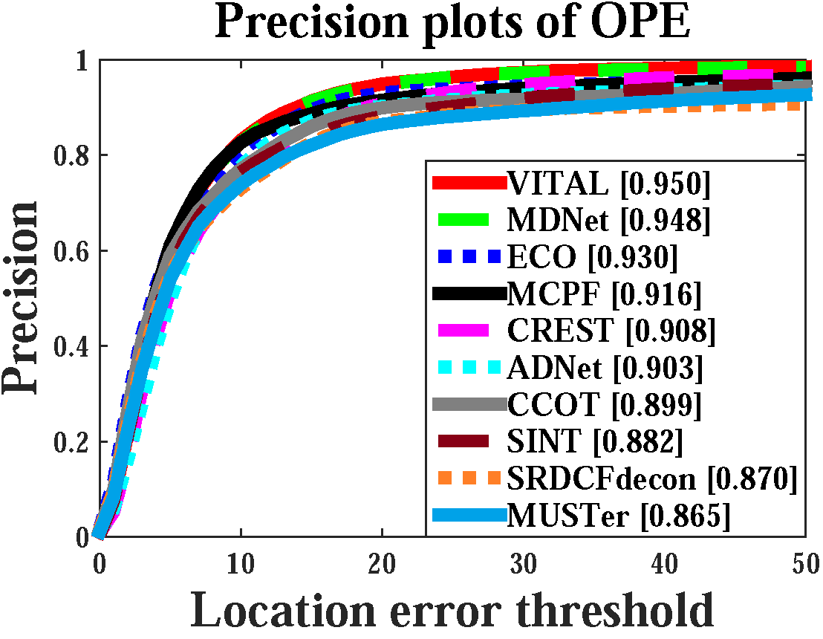
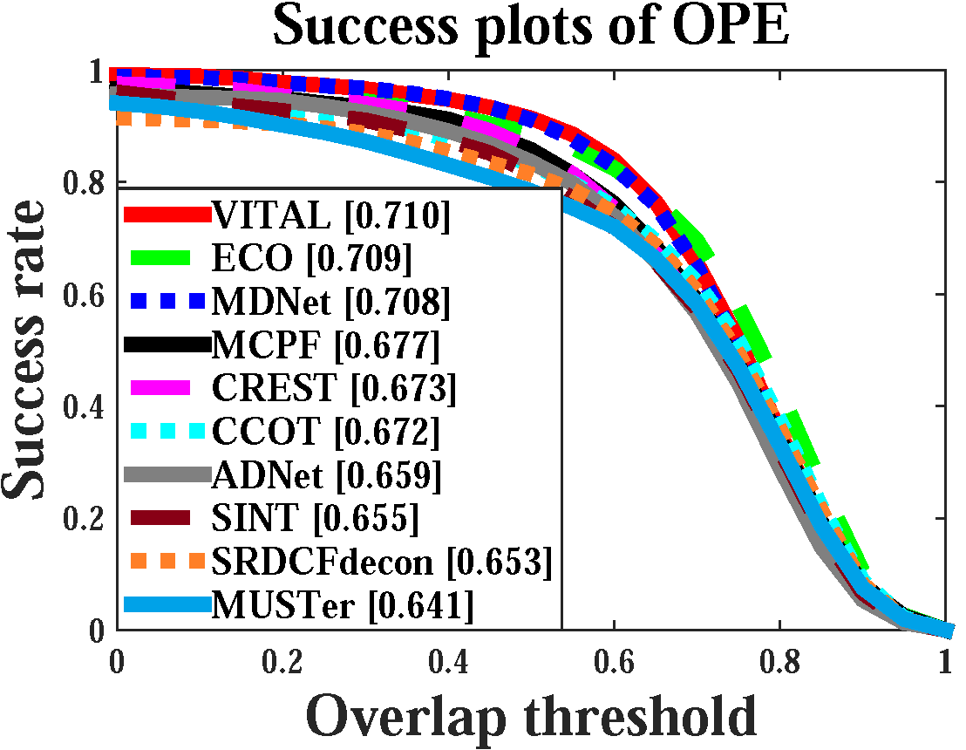
Experiments:
External analysis: OTB-2013 dataset
Notes:
We evaluate the proposed tracker, VITAL, on the visual tracking OTB-2013. The distance precision and overlap success rates shown in these figures indicate that the proposed tracker performs favorably against state-of-the-art approaches.

Slide 23
Experiments:
External analysis: OTB-2015 dataset
Notes:
We evaluate the proposed tracker, VITAL, on the OTB-2015 dataset under standard metrics. Since the OTB-2015 dataset contains more videos with large scale changes and low resolution, our VITAL
tracker does not perform as well as ECO in overlap success.

Slide 24
Take-home messages:
1. Class imbalance exists in tracking-by-detection framework.
2. We use GAN to augment positive samples to capture appearance changes temporally.
3. We propose cost sensitive loss to reduce easy negative effects.
4. State-of-the-art performance on the benchmark datasets.
Notes:
In sum, we propose a tracking-by-detection framework with adversarial learning scheme to adaptively enrich the target feature representations in the CNN feature space. It reduces the overfitting problem of the classifier when it handles target appearance variations over the whole temporal sequences. Meanwhile, we propose a cost sensitive loss to reduce the effect of easy negative samples for overcoming the class imbalance problem. We adopt both strategies in the training step to generalize a temporally robust classifier which improves the baseline while achieving favorable performance on the standard benchmarks.

